Slide 1

Insurance Sales & Performance Analytics Dashboard
Overview
This presentation outlines the systematic approach taken to analyze key business metrics, leveraging a combination of MySQL, Excel, Power BI, and Tableau to transform raw data into actionable insights. Discover how each tool contributed to a comprehensive understanding of sales performance, pipeline health, and achievement against targets.
Under the Supervision of
Anand Babu
(EXCELR)
Submitted by Soumyadeep Das
(Group 5)

Slide 2






Presentation Outline
Key Performance Indicators Tracked
Yearly & Current Year Meeting Counts
No. of Invoices by Account Executive and Meetings by Account Executive
Stage Funnel by Revenue and Top Open Opportunities
Budget Targets vs. Achievements
Excel, Power BI, Tableau Dashboard, My SQL Outputs and Findings & Takeaways from the Project

Slide 3
Key Performance Indicators Tracked
This project focused on developing robust analytical capabilities to track and report on a comprehensive set of key performance indicators across sales performance, pipeline health, and target achievement.
Performance Tracking
Pipeline Health
Target Achievement
Account Executive Yearly Meeting Count
Stage Funnel by Revenue
FY Targets (New, Cross-sell, Renewal)
Top 4 Open Opportunities
Placed Achievement (New, Cross-sell, Renewal)
No. of meetings for the current year
Top 10 Open Opportunities
No. of meetings by Account Executive
Open Opportunities (Stage 'Propose Solution' & 'Qualify Opportunity')
Invoiced Achievement (New, Cross-sell, Renewal)
Total Open & Total Opportunities
Percentage of Achievement (Placed/Budget, Invoiced/Budget)
Insight: By diligently tracking these KPIs, we provide a holistic view of business performance, enabling data-driven decisions and continuous improvement.

Slide 4





Yearly & Current Year Meeting Counts
The Challenge
Excel Application
Determining total meetings yearly and specifically
for the current year to assess engagement trends.
Leveraged using PivotTables, enabled flexible analysis of both annual meeting volumes and current year progress.
MySQL Solution
Power BI/Tableau
Using COUNT queries on the meetings table extracted
the both yearly and year-to-date (YTD) counts.
Written a formula to calculate the meeting count and
represented it in tabular format.
Insight : This analysis clearly demonstrated the correlation between meeting frequency and overall sales activity, identifying productive
behaviours and areas for coaching.

Slide 5
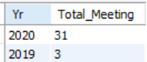
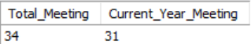
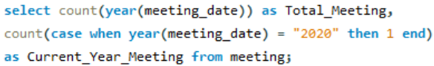
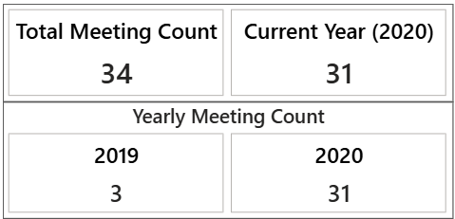
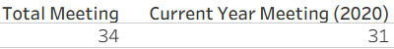
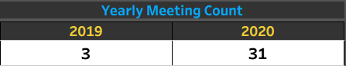
Yearly & Current Year Meeting Counts
My SQL
Row Labels | Count of meeting_date (Year)
2019 | 3
2020 | 31
Grand Total | 34
My SQL :
Excel
Tableau :
Power BI
Powe BI :
Tableau

Slide 6
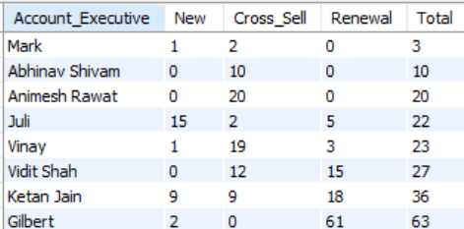
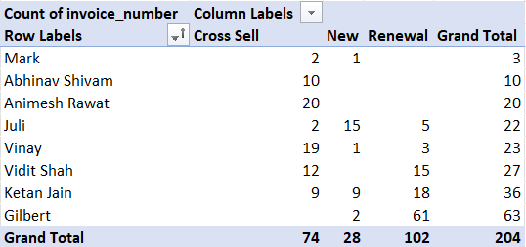
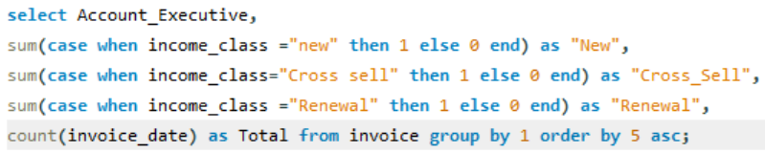
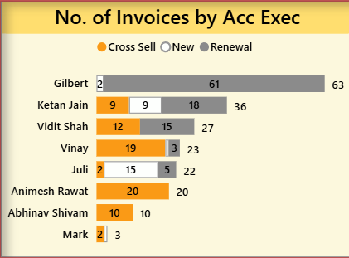
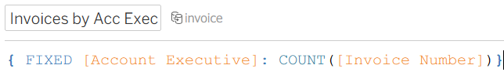
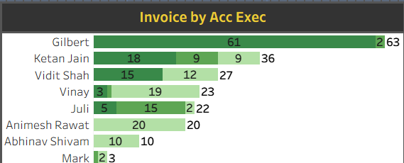
No. of Invoices by Account Executive
My SQL
1
MySQL : Utilized a query grouping invoices by Account Executive ID to count
individual invoice volumes.
Excel
2
Excel : Created a dynamic PivotTable summarizing invoice counts per Account
Executive for easy filtering and review.
3
Power BI/Tableau : Developed a clear bar chart visualization, allowing
immediate identification of invoice volume by Account
Executive, aiding in performance comparison.
Power BI
Tableau :
Powe BI :
Tableau
Insight : This analysis highlighted top performers and provided critical visibility into
workload distribution across the team, identifying potential areas
for resource re-allocation or support.

Slide 7
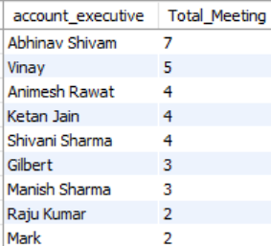

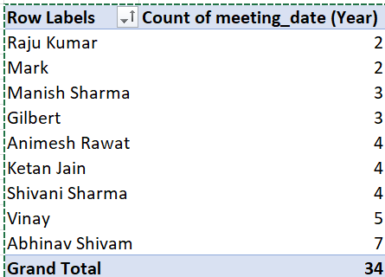


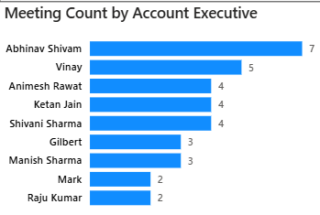
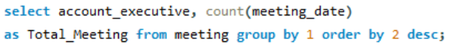

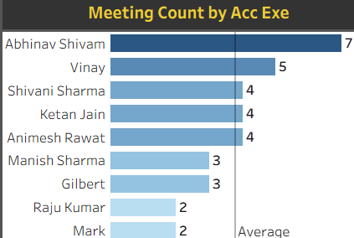
Meetings by Account Executive
My SQL
The Challenge
Determining How many meetings did each Account Executive hold?
Visualisation (Power BI/Tableau)
Excel
An interactive dashboard was designed, providing a bar chart representing the individual Account Executive meeting statistics in detail.
MySQL Solution
Tableau :
Data was aggregated by Account Executive ID, counting all associated meetings.
Powe BI :
Power BI
Excel Application
A PivotTable was configured with an Account Executive slicer, allowing quick filtering and comparison of meeting volumes.
Tableau
Insight : This analysis clearly demonstrated the correlation between meeting frequency and overall sales activity,
identifying productive behaviours and areas for coaching.

Slide 8
Stage Funnel by Revenue
Question
1
What is the revenue distribution across opportunity stages?
MySQL
2
Aggregated revenue grouped by opportunity stage for a holistic view.
Excel
3
Generated a clear funnel chart using revenue sums per stage, highlighting potential drop-off points.
Power BI/Tableau
4
Utilised a dynamic funnel visualisation displaying both revenue and opportunity counts, providing deep insights into conversion rates and bottlenecks at each stage.
Insight: This granular view enabled the identification of critical bottlenecks and the precise calculation of conversion rates, empowering targeted interventions to improve sales velocity.

Slide 9
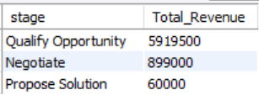
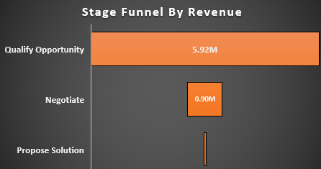
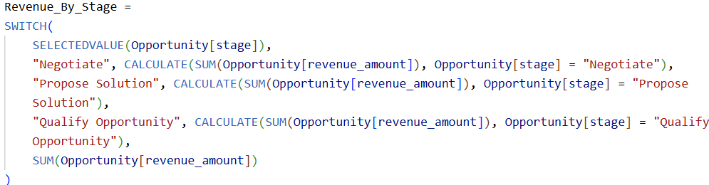
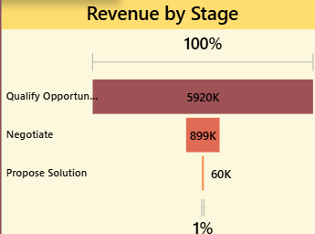
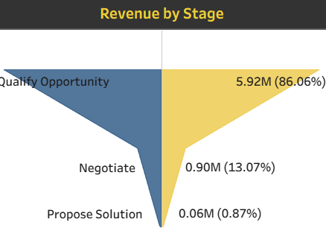
Stage Funnel by Revenue
My SQL
My SQL :
Excel
Powe BI :
Power BI
Tableau

Slide 10
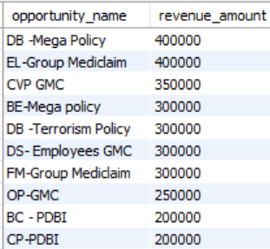

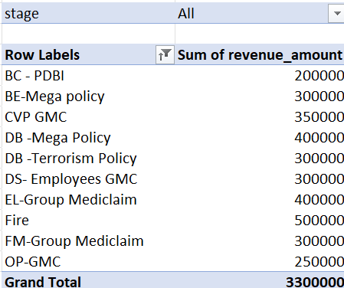


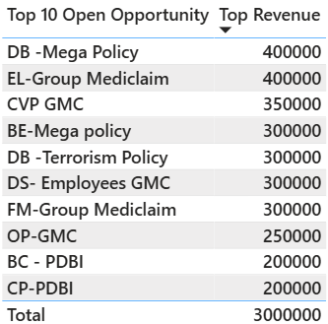
Top Open Opportunities
My SQL
Business Question: Which are the highest value open opportunities?
Excel : Using pivot table applied filters and sorting to open opportunities by value, allowing
for manual review and strategising.
MySQL : Selected and ordered the top 10 open opportunities by their potential revenue, providing
a quick priority list.
Excel
Power BI/Tableau : Created a bar charts that vividly highlighted the top 4 and table visual for top
10 deals, making prioritisation of sales focus immediate and data-driven.
Tableau :
Powe BI :
Power BI
Insight: By focusing on the highest value open opportunities, the team can strategically allocate resources and efforts to maximise potential revenue realisation.

Slide 11




Budget Targets vs. Achievements
The Question
Excel Display
Comparing financial targets with actual placed and invoiced achievements across new business, cross-sell, and renewal categories.
Introduced calculated fields to determine the Percentage of Achievement (Achieved/Budget) for both placed and invoiced figures, providing clear performance indicators.
MySQL Approach
Power BI/Tableau Visualization
Performed intricate joins across budget, brokerage, fees, and invoice tables, categorizing data by new, cross-sell, and renewal streams.
Implemented intuitive gauge charts and percentage achievement visualizations, offering an immediate and compelling view of performance against targets.
Insight: This comprehensive analysis revealed precise performance gaps and highlighted areas of success across all revenue streams, enabling targeted interventions and celebrating achievements.

Slide 12
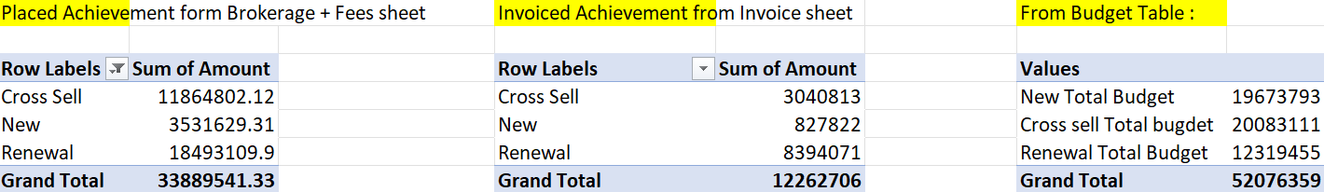
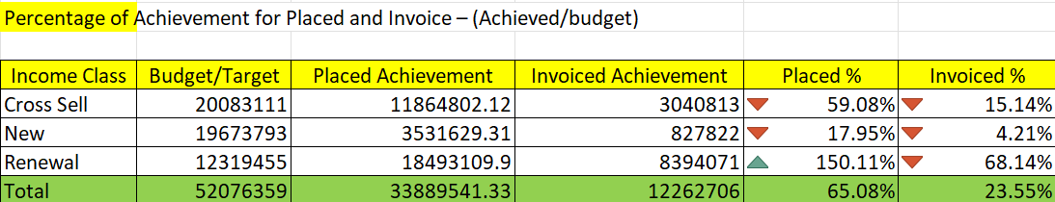
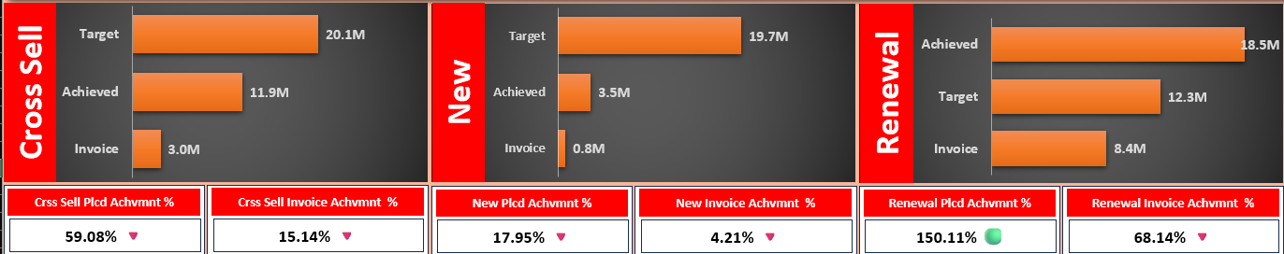
Budget Targets vs. Achievements
Excel
Result

Slide 13
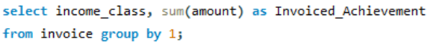
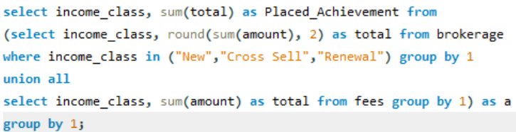
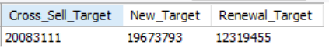
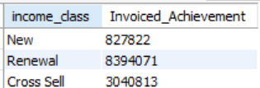
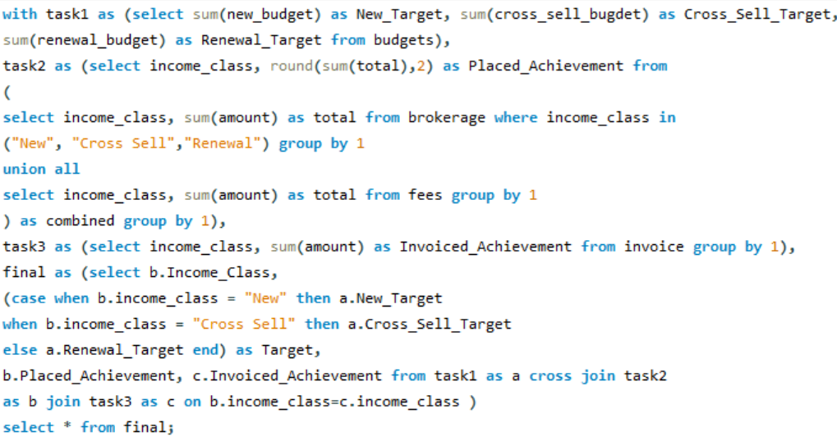
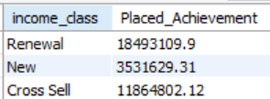
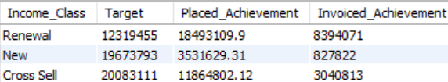
Budget Targets vs. Achievements
Target :
My SQL
Inv. Achv :
Result
Plcd. Achv :

Slide 14
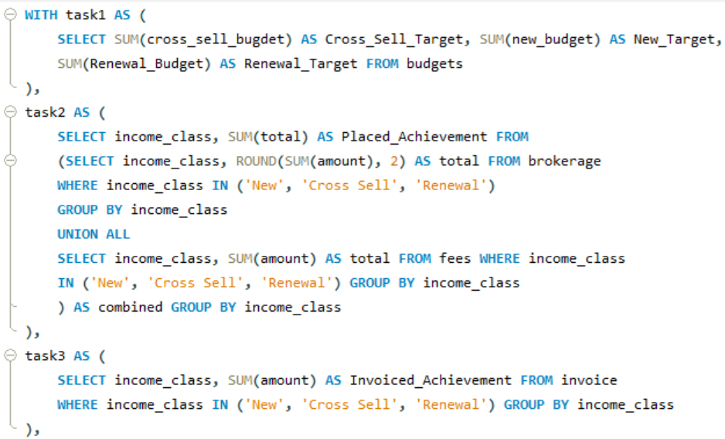
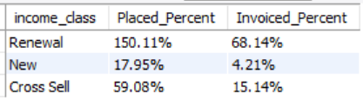
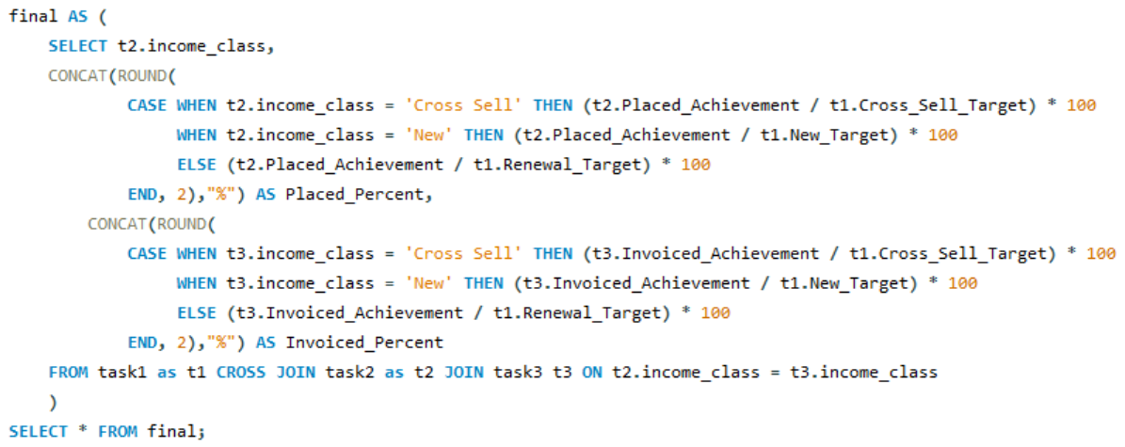
Budget Targets vs. Achievements
My SQL
Result
Plcd and Inv. % :

Slide 15
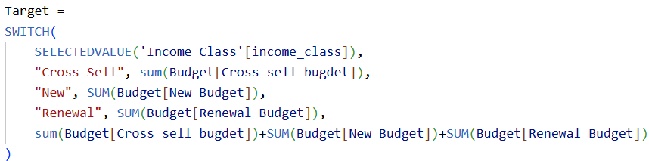
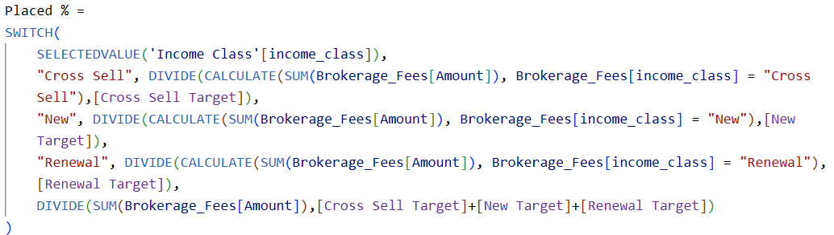
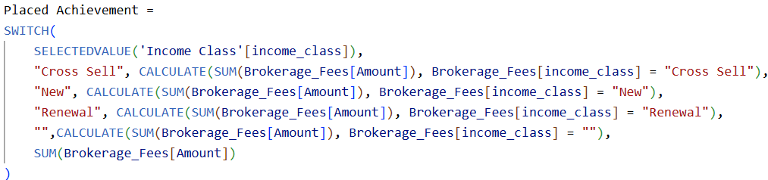
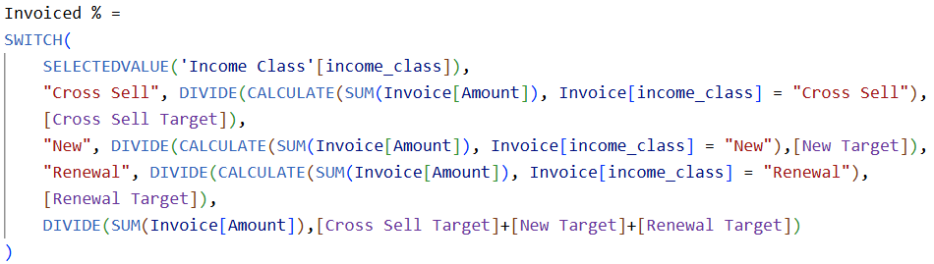
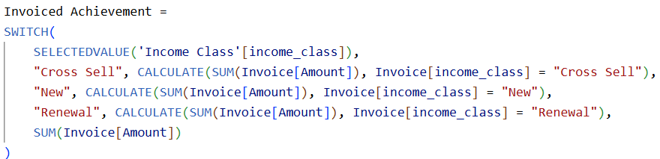
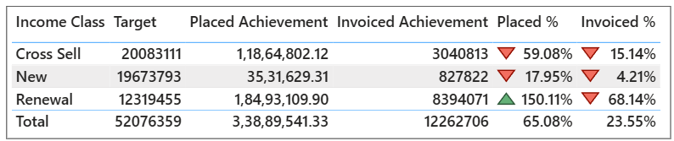
Budget Targets vs. Achievements
Power BI
Plcd and Inv. % :
Target :
Plcd. Achv :
Inv. Achv :
Result

Slide 16
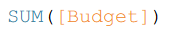
Budget Targets vs. Achievements
Tableau
Target :
Select the New, Cross Sell & Renewal Budget column from budget table & right click & select pivot, rename the column to income class & and other to budget.
Inv. Achv :
Plcd. Achv :
Merge the brokerage and fees table to calculate the sum of amount.
Plcd and Inv. % :
Result

Slide 17
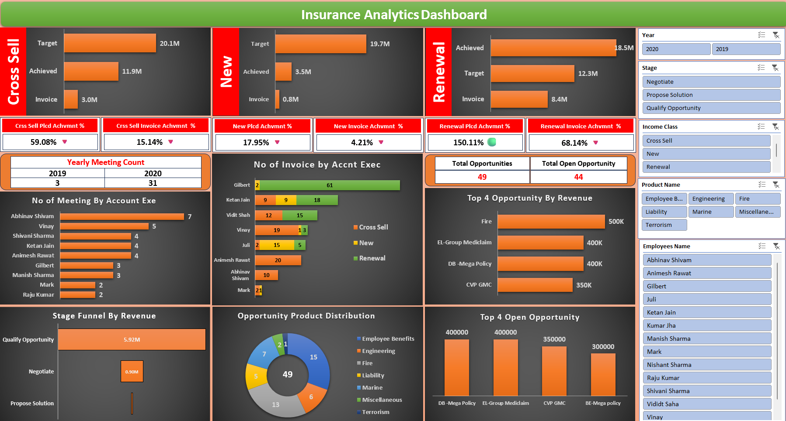
Excel Dashboard

Slide 18
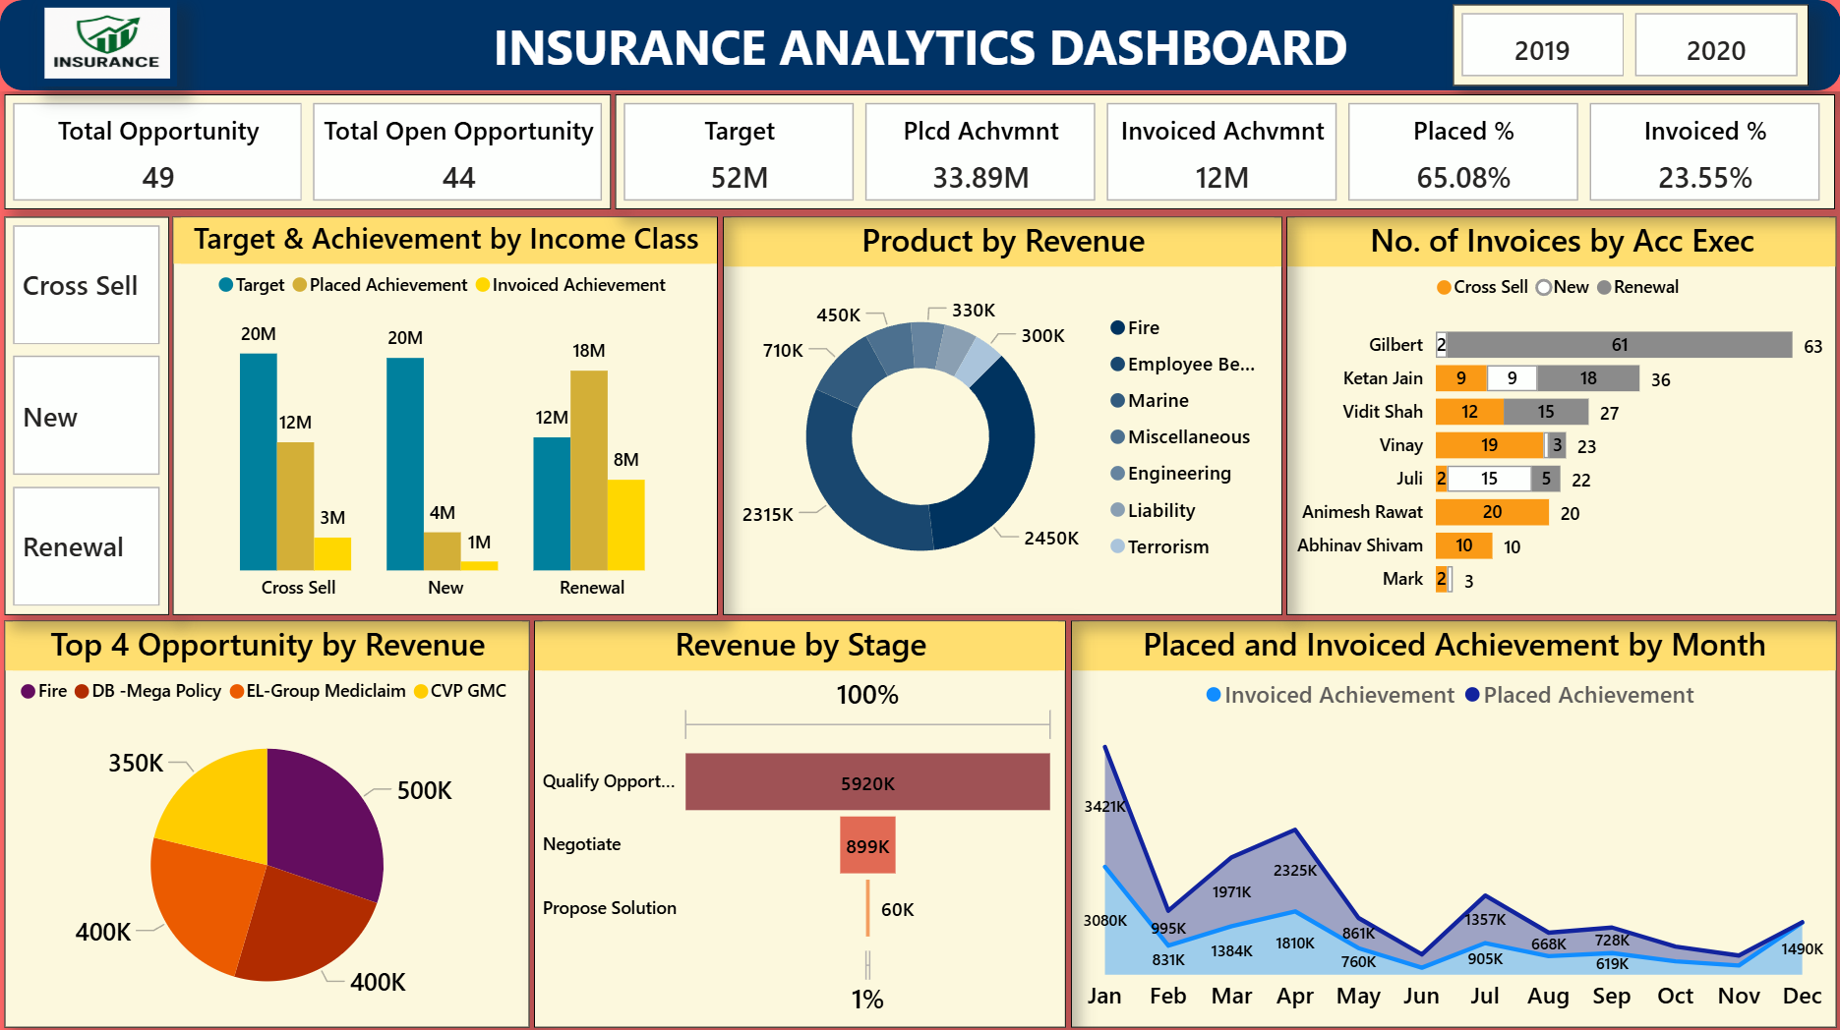
Power BI Dashboard

Slide 19
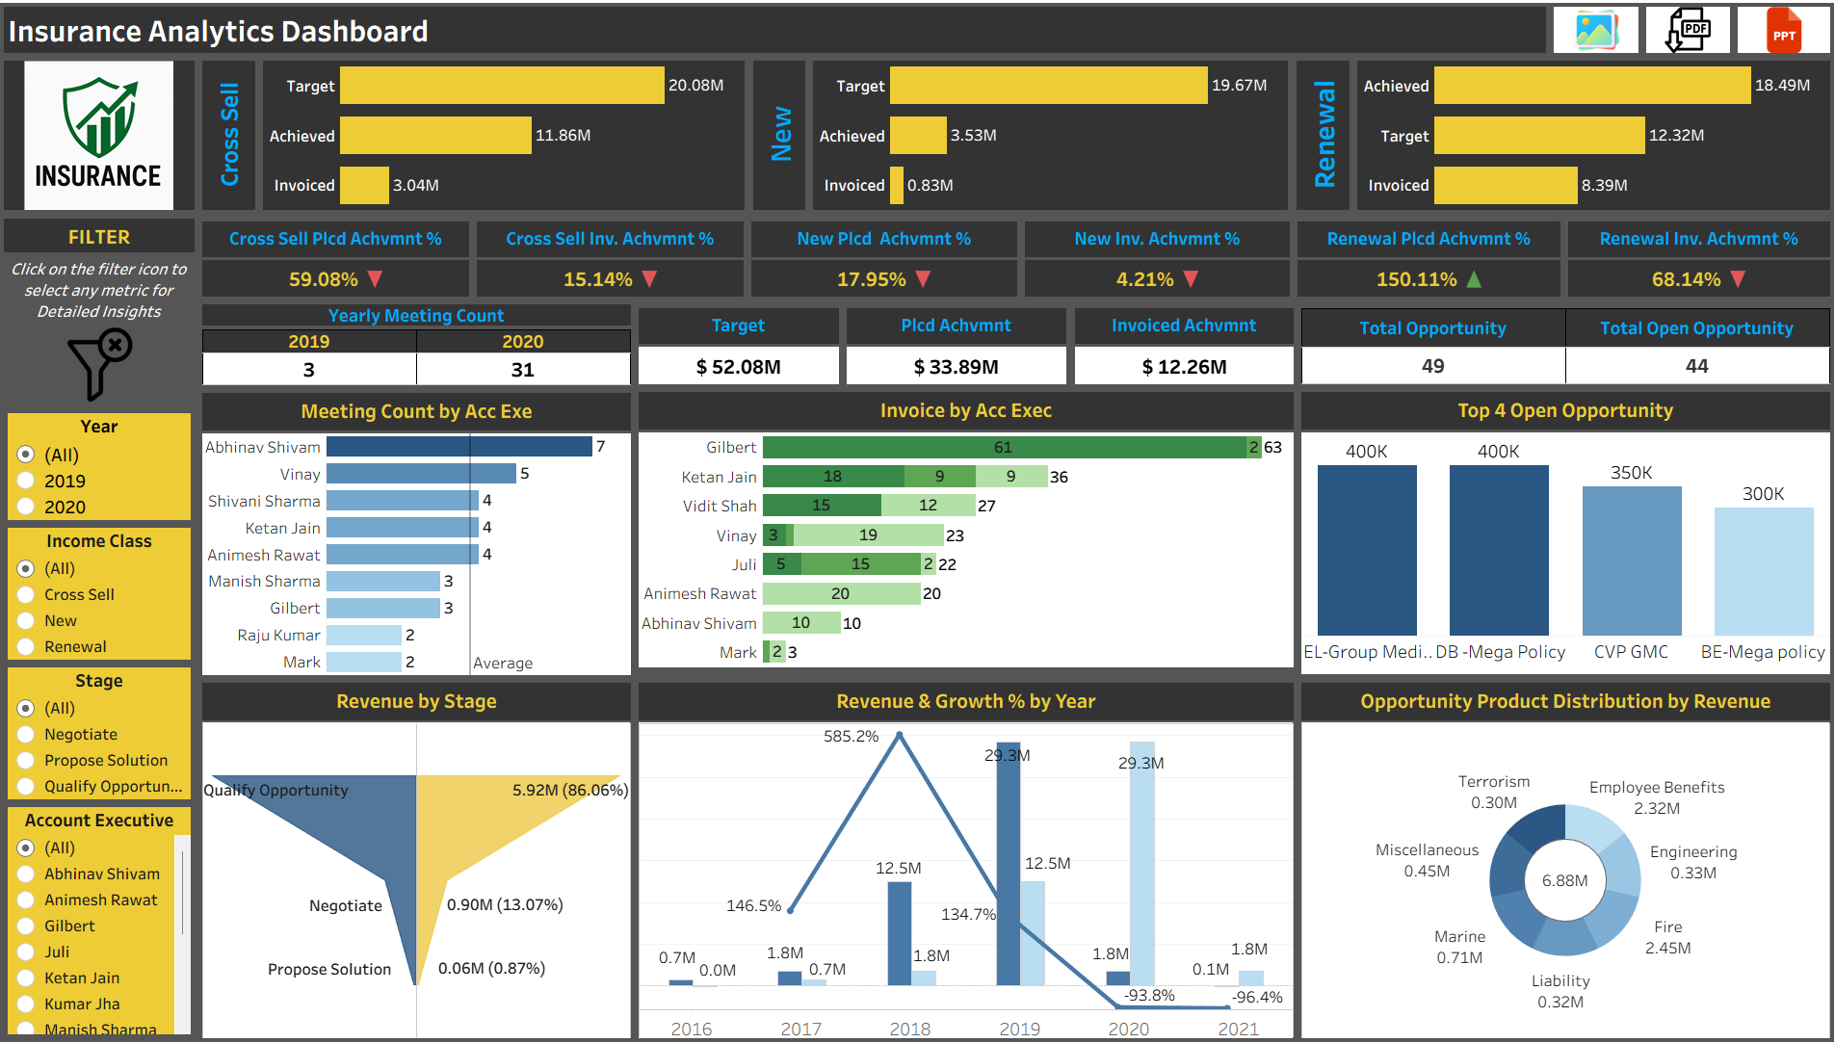
Tableau Dashboard

Slide 20
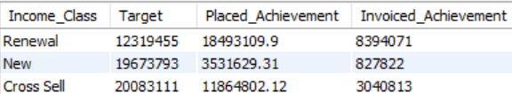
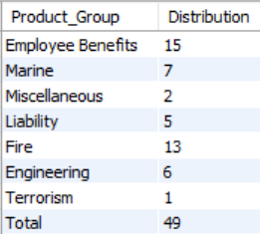



SQL Query Outputs
Placed, Invoiced, Placed% & Invoiced% by Income Class
Yearly Meeting Count
Meeting Count by Acc Exec
Invoice Count by Acc Exec
Opportunity Product Distribution
Stages by Revenue
Top 4 Opportunity
Top 4 Open Opportunity

Slide 21
Findings & Takeaways from the Project
This project successfully delivered a 360° view of insurance business performance across Cross Sell, New Business, and Renewals, leveraging MySQL, Excel, Power BI, and Tableau for a seamless analytics workflow.
Key Insights & Learnings
Revenue Growth Patterns: Significant growth in 2018 (585%), followed by a decline, indicating dependency on a few big opportunities.
Cross Sell vs. Renewal: Renewal (150% achievement) outperformed Cross Sell (59%) and New Business (18%), showing stronger repeat business.
Stage-wise Revenue Concentration: Majority of revenue from the 'Qualify Opportunity' stage, highlighting conversion risk.
Top Accounts & Products: Key executives (e.g., Gilbert, Ketan Jain) and specific policies (Fire, EL-Group Mediclaim, Mega Policy) drive bulk revenue.
Target vs. Achieved Imbalance: Large gap in Cross Sell and New business suggests critical areas for improvement focus.
Visualisation Learnings: Employed advanced Tableau techniques: dual-axis, KPI indicators, bar-line combo charts, and custom X-axis shifting.
What We Learned
How to build interactive Tableau dashboards combining multiple KPIs and visualizations.
The importance of data storytelling: aligning visuals with key business questions (e.g., Who drives revenue? Where are the gaps? What's the growth trend?).
Hands-on experience in data transformation, calculated fields (LY Amount, Growth %), and visualisation best practices.
How dashboards can drive strategic decision-making in insurance by identifying growth opportunities, risks, and top-performing areas.

Slide 22
Thank You
We appreciate your time and attention.
Please feel free to reach out with any questions.

